Slide 1
Charla de Convivencia Escolar
Esfuerzo de toda la comunidad escolar para educar, sensibilizar y motivar
Francisco X. San Miguel Torres, PhDC

Slide 2
Bullying Mitos y la Falta de Conocimiento
Eso no pasa aquí
En esta escuela no hay bullying
Eso te hace más fuerte, hay que desarrollar resilencia
Así es en todos lados
Es que tu hijo lo cuca
“¿Tú le has dicho que eso te molesta, que pare?”
Los nenes son así, se pasa molestándose

Slide 3
Bullying – La verdad
La incidencia es alta en TODO el mundo
Existe en TODAS las escuelas
Tiene múltiples efectos y consecuencias negativas
Hacerle daño a otro NO ES ACEPTABLE
Tenemos pocas herramientas, conocimientos y destrezas para reconocer, prevenir y manejar el acoso escolar
Requiere de TODA la comunidad escolar, estudiantes, padres, maestros, consejeros, directores, psicólogos, otros adultos, etc.
El conocimiento profundo merma el bullying

Slide 4
World AntiBullying Forum & UNESCO (2023)

Slide 5
World AntiBullying Forum & UNESCO (2023)
(WABF) y UNESCO redefinieron acoso escolar
como un proceso social dañino caracterizado
por desbalance de poder impulsado por normas
sociales e institucionales. El bullying es a menudo
repetido y se manifiesta como un comportamiento
interpersonal no deseado entre estudiantes o
personal de la escuela que causa daño físico, social
y emocional a los individuos o grupos perseguidos,
y la comunidad escolar.

Slide 6
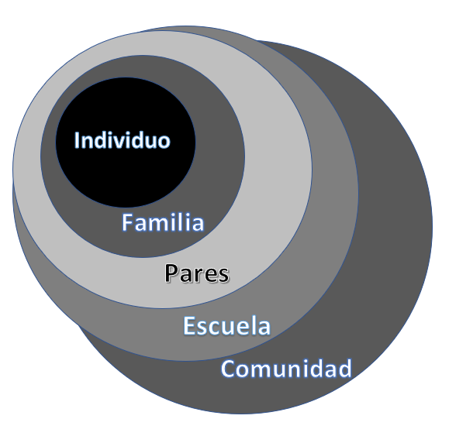
El Fenómeno Social Incluye a Todos
CAMBIO DE PARADIGMA

Slide 7
Me faltó el que maneja la Guagua Escolar

Slide 9
Community Based View of Bulling
International – Full Integration
Empatía y comunicación.
El hijo vé un 6, yo veo un 9.

Slide 10
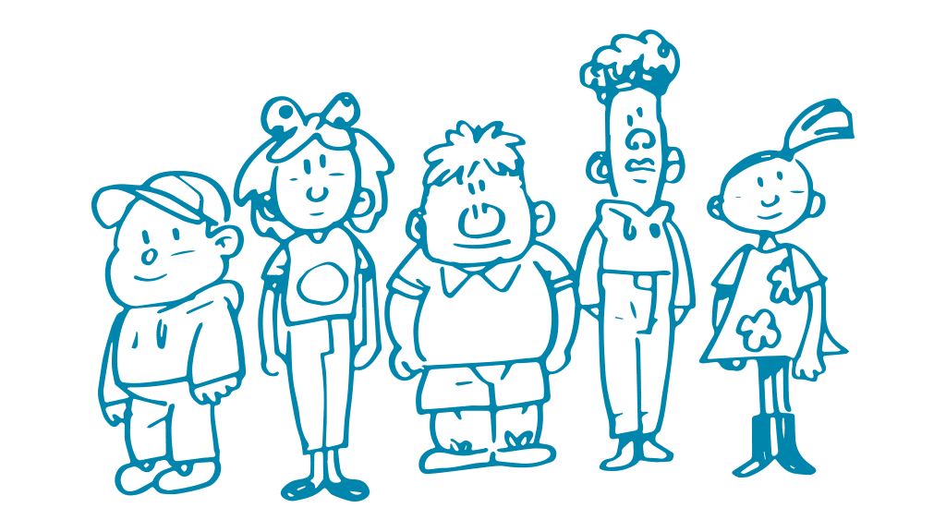
Película corta explicando
el fenómeno social

Slide 15
Empathy with student, teacher…
How can we fix this?

Slide 16
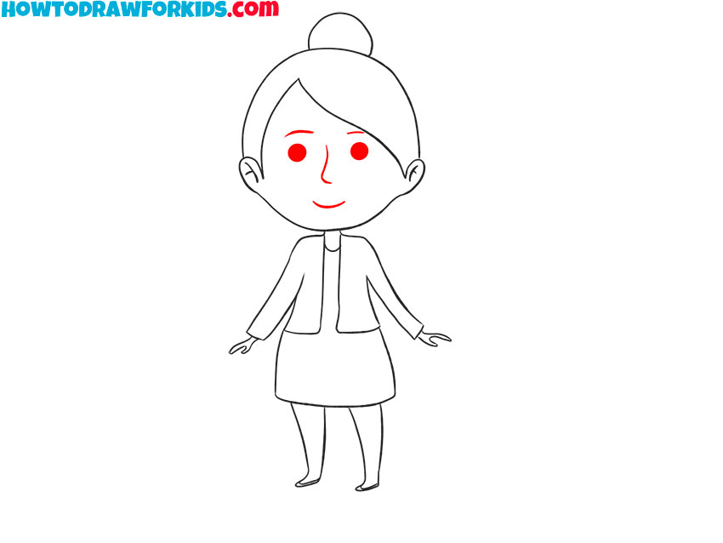
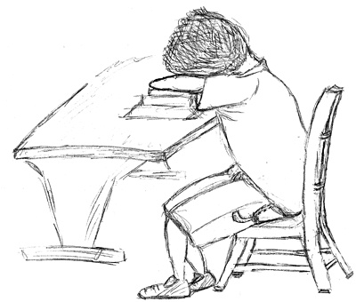
TEACHER
6
SAD STUDENT

Slide 18
MORAL DISENGAGEMENT

Slide 19
PONGO EL FOCO EN MÍ

Slide 20
¿Qué puedo hacer?

Slide 22
Activa tu cuenta en Tik Tok e Instagram
Para hablar el mismo idioma
“Family Bonding”
Tu hijo puede bloquearte de comentarios de otros (confidencialidad)
Conocer restricciones y opciones (negociar con ellos)
Ej. Quiet mode luego 9 pm
Usa TODOS los APPS que usan
SnapChat – opción que no puedes ver mensajes pero sí quienes son los amigos de sus hijos
Piensa antes de SEND
No lo envies
Refrasea el mensaje
Bloquea al “Sender”
Reporta al “Sender”
Reporta la comunicación específica
Tik Tok bajo Family (Guardian) Safety Mode & Screentime & Family Pairing
Oportunidad de presentar cómo has sido acosado
Instagram Parental Guide & Family Center

Slide 23
Social Media Family Center y ACCIÓN
Herramienta para padres para controlar tiempo de utilización
Recobrar confianza
Saber qué hacen (conocerlos)
Oportunidad de “Delete” comentarios e imágenes inapropiadas de…….
“Unfriend” o “Delete” amigos que no conocen personalmente
Quitar info personal que puede ser peligrosa compartir
Salirse de chats, grupos o plataformas
Utilización positiva
Justicia social
Uso práctico - ¿Cómo se arregla..
“¿Estás bien…?
Mensajes positivos
Socializar, encontrar pares
DELETE DAY en escuela(actividad)
Oportunidad de pertenecer y mover el círculo del bullying
“NO PLACE FOR FEAR”

Slide 24
Saber qué es legal y qué no
School personnel are morally and legally obligated to provide a safe educational environment for all students—one that is free from discrimination. Title IX of the Educational Amendments of 1972 requires schools to prevent and address sexual harassment and sex discrimination.
Hinduja, Sameer; Justin W. Patchin. School Climate 2.0: Preventing Cyberbullying and Sexting One Classroom at a Time (p. 36). SAGE Publications. Kindle Edition.
I wish you were dead
You r ugly as s*@%
I forwarded that picture to everyone
Could you be any fatter?
Pato, fag, mari$#&
I hate u
Move out of the country
Your nose is huge
Dumbo
Send me a pic in bra

Slide 25
Cyberbullying Education Objective
to enlighten educators, parents, and teens about the tremendous importance of cultivating a positive school climate, not only to enhance student achievement, success, and productivity but also to produce students who are safe, smart, honest, and responsible while using technology.
Hinduja, Sameer; Justin W. Patchin. School Climate 2.0: Preventing Cyberbullying and Sexting One Classroom at a Time (p. 42). SAGE Publications. Kindle Edition.
“I am not going to post that online—Mrs. Smith is my favorite teacher and is really awesome and I don’t want her to think badly of me!”
“I don’t want my friends at school to think I was a moron for sending that message.”
“I am totally going to keep my profile page clean, since everyone else at my school does it too.”
“I don’t want to miss out on any opportunities and fall behind my peers, and so I have got to build a positive online reputation!”
“I don’t want to stand out for doing the wrong thing when everyone else is doing the right thing!”
Hinduja, Sameer; Justin W. Patchin. School Climate 2.0: Preventing Cyberbullying and Sexting One Classroom at a Time (p. 40). SAGE Publications. Kindle Edition.

Slide 28
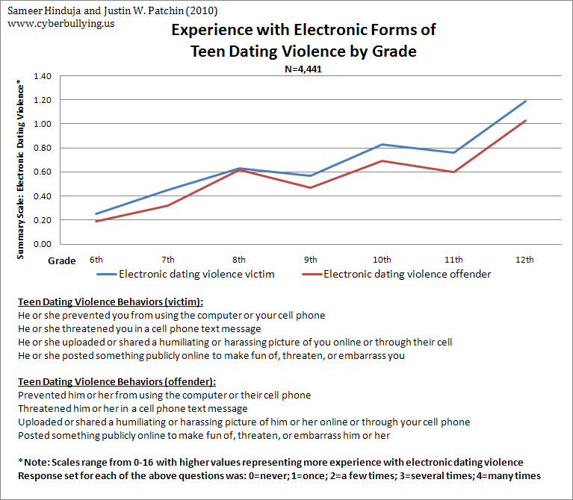

Slide 29
We have recently shared that electronic dating violence among teenagers is one of the facets of adolescent technology misuse we are exploring. Please see the previous referenced blog for foundational information. Today, I wanted to share with you our research results from our 2010 data. This is based on a random sample of approximately 4,400 11-18 year-old youth from a large school district in the southern United States. The demographic characteristics of the sample were statistically representative of the entire population of middle school and high school students in this district. If you would like further information about methodology, please let me know. VICTIMIZATION • 10% of youth said a romantic partner has prevented them from using a computer or cell phone. • 6% of boys and girls say their romantic partner posted something publicly online to make fun of, threaten, or embarrass them. • 10.4% of boys and 9.8% of girls said they received a threatening cell phone message from their romantic partner. • 5.4% of boys and 3.4% of girls said their romantic partner uploaded or shared a humiliating of harassing picture of them online or through their cell phone

Slide 30
OFFENDING • 7% of youth admitted that they prevented their romantic partner from using a computer or cell phone. • 6% of boys and 4% of girls say they posted something publicly online to make fun of, threaten, or embarrass their romantic partner. • About 7% of youth said they sent a threatening cell phone message to their romantic partner. • 5% of boys and 3% of girls said they uploaded or shared a humiliating of harassing picture of their romantic partner online or through their cell phone

Slide 31
RELATIONSHIPS • Victims of traditional (offline) dating violence are significantly more likely to be victims of electronic forms of dating violence (r=.75) than those who have not experienced offline bullying • Those who admit to engaging in traditional dating violence also report engaging in electronic forms of dating violence (r=.77) • Victims of dating violence (r=.51) and specifically electronic forms of dating violence (r=.64) are significantly more likely to also be victims of cyberbullying • Youth who are cyberbullied are 3.6 times as likely to experience electronic teen dating violence • Youth who admit to engaging in dating violence (r=.52) and specifically electronic forms of dating violence (r=.65) also admit to engaging in cyberbullying • Youth who share their passwords with their significant other are nearly three times as likely to be victims of electronic dating violence • Older students reported more experience with dating violence

Slide 32
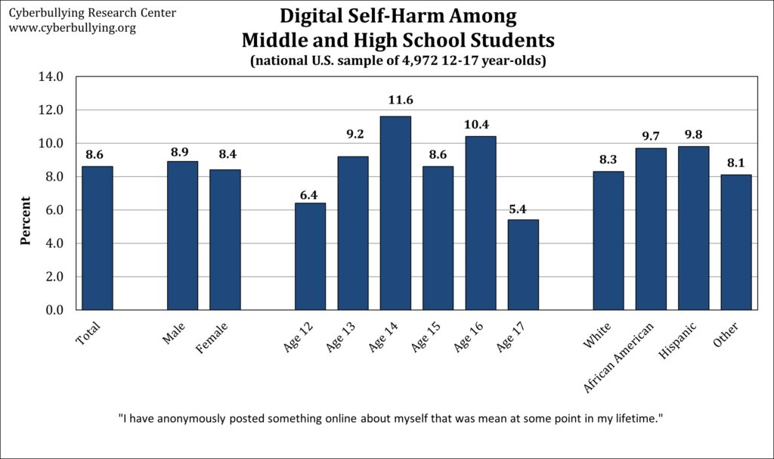
2019 from a national sample of 4,972 12- to 17-year-olds in the United States

Slide 33
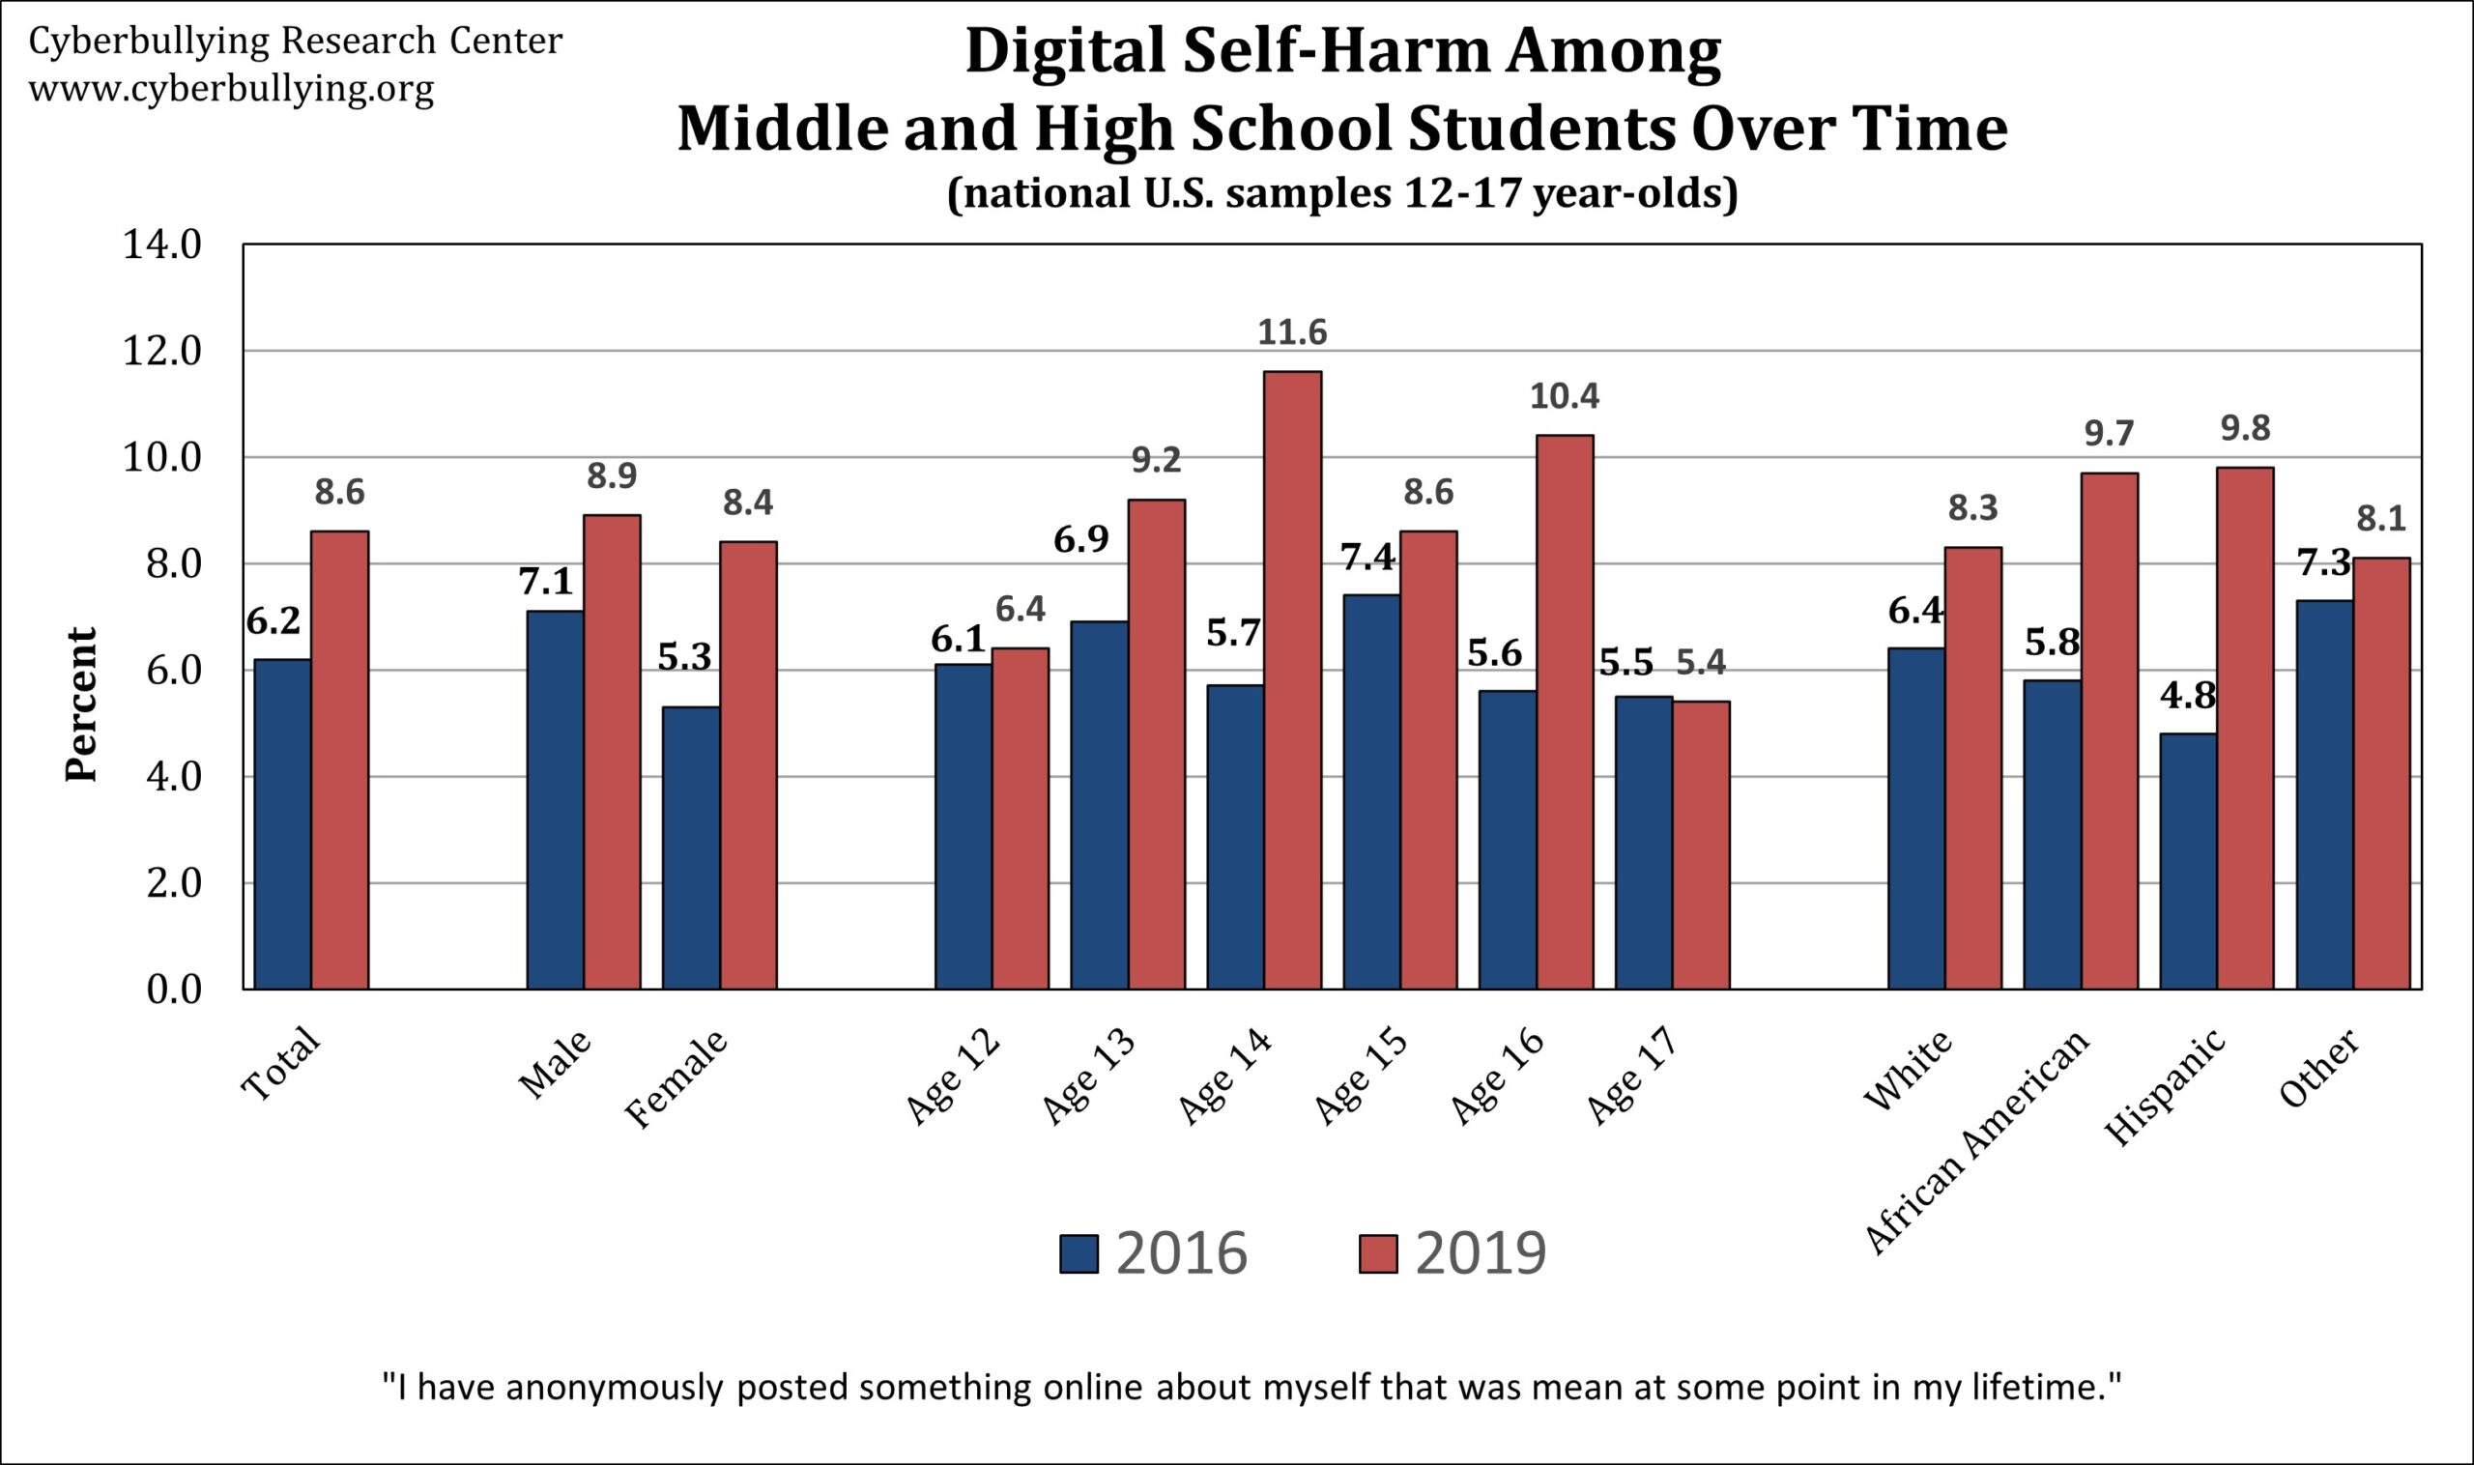
2019 from a national sample of 4,972 12- to 17-year-olds
in the United States

Slide 34
Distribution and possession of child pornography
Mishna, U Toronto 2023

Slide 35
Mishna, U Toronto 2023

Slide 36
Mishna, U Toronto 2023

Slide 37
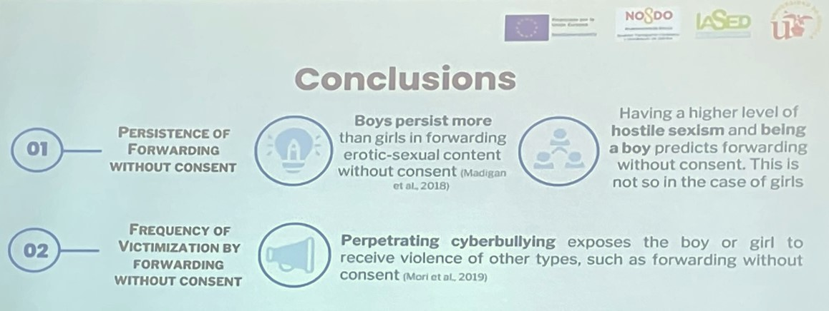
Machismo y Persistencia

Slide 38
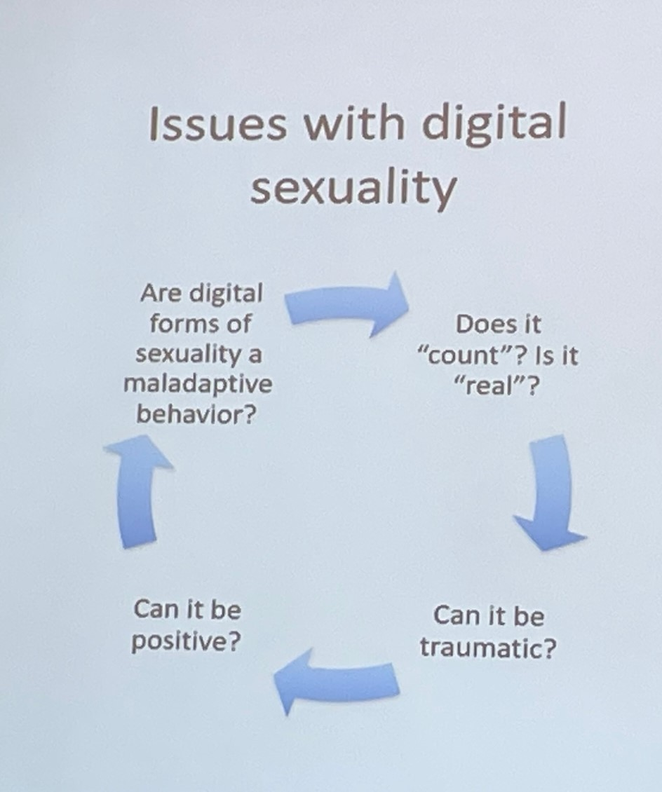
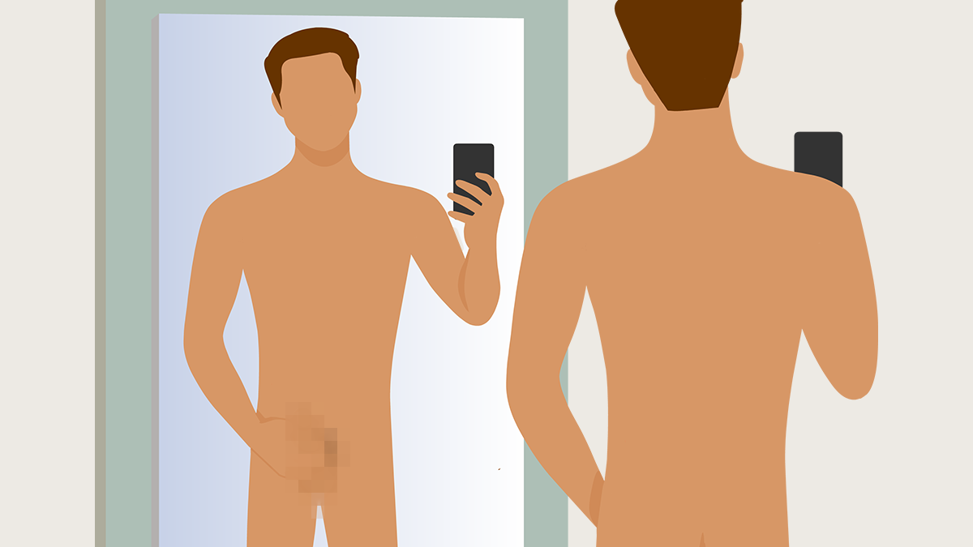

Slide 39
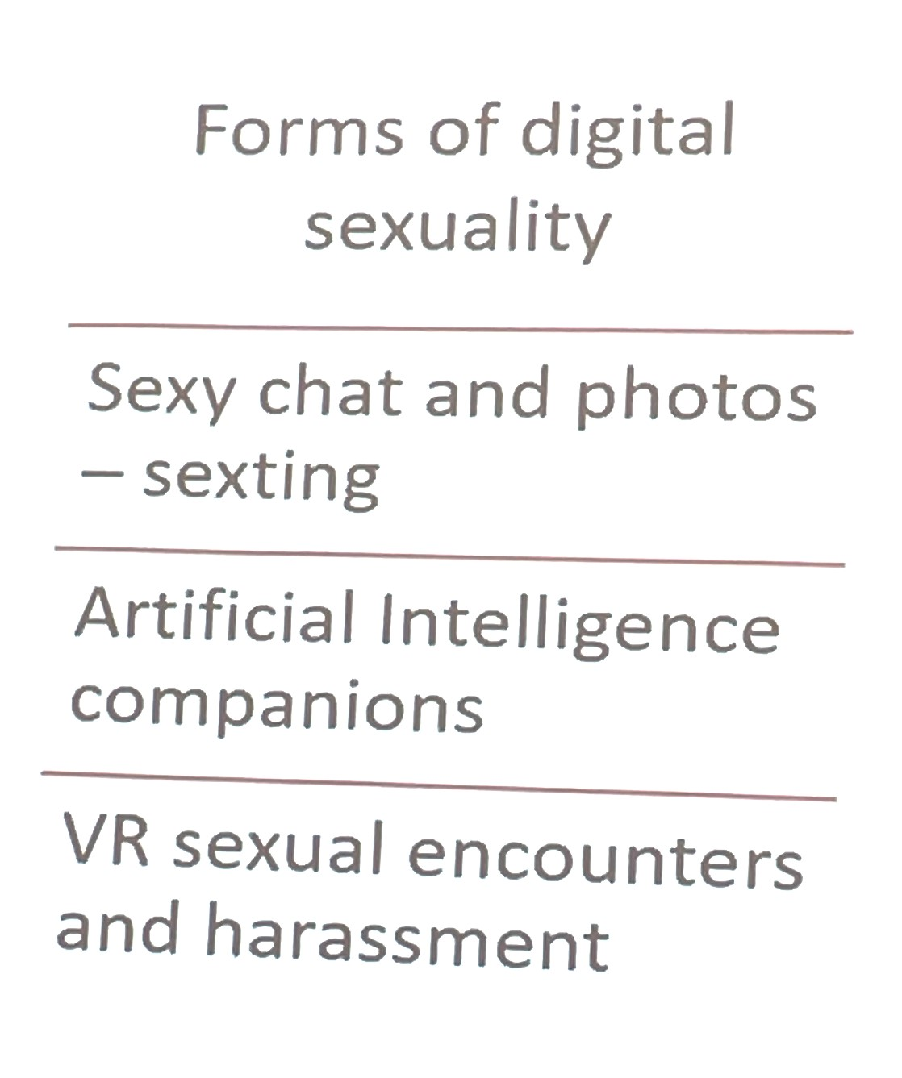
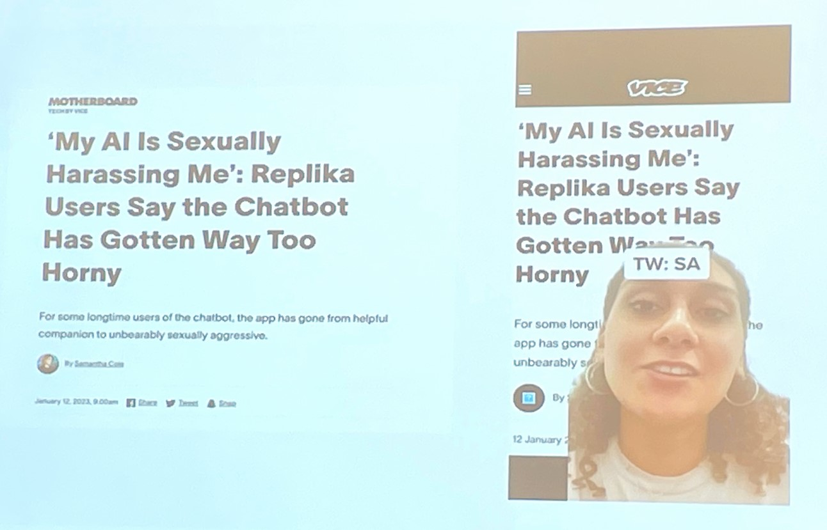

Slide 41
1 out of 2

Slide 42
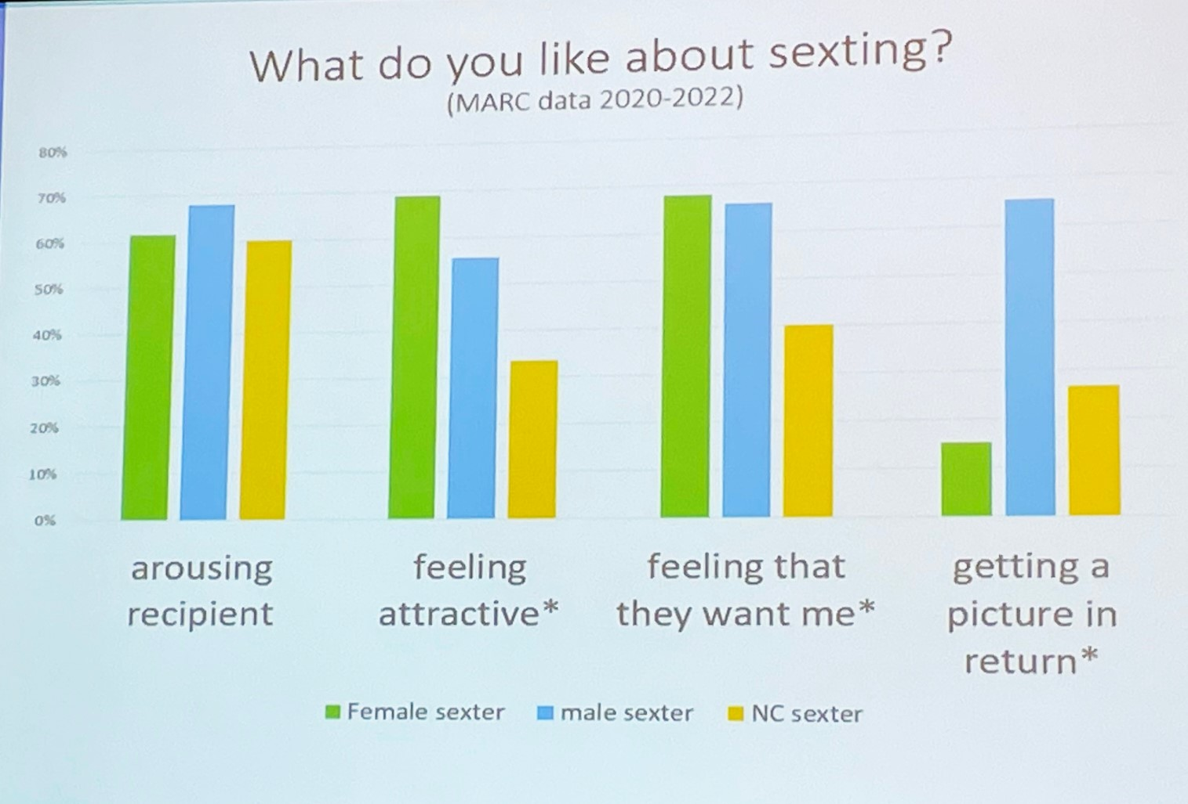

Slide 48
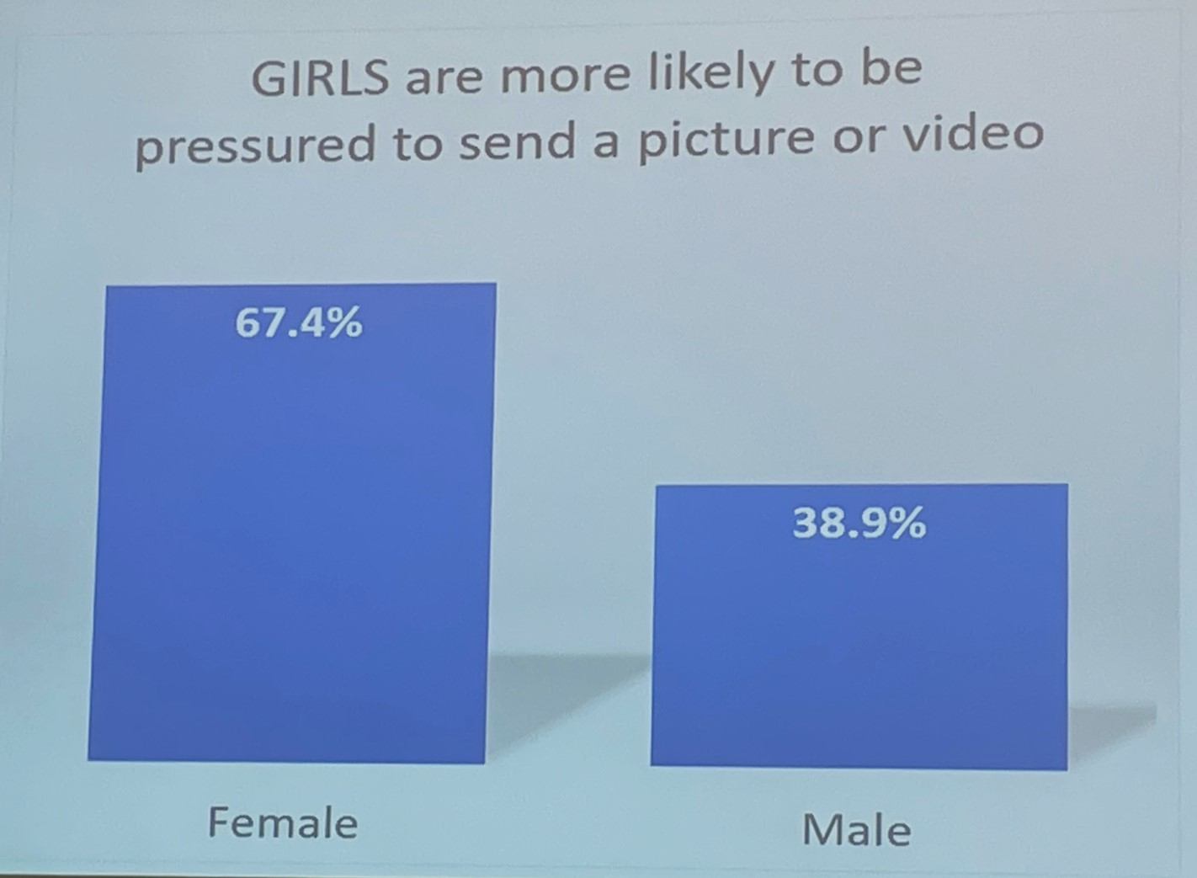

Slide 49
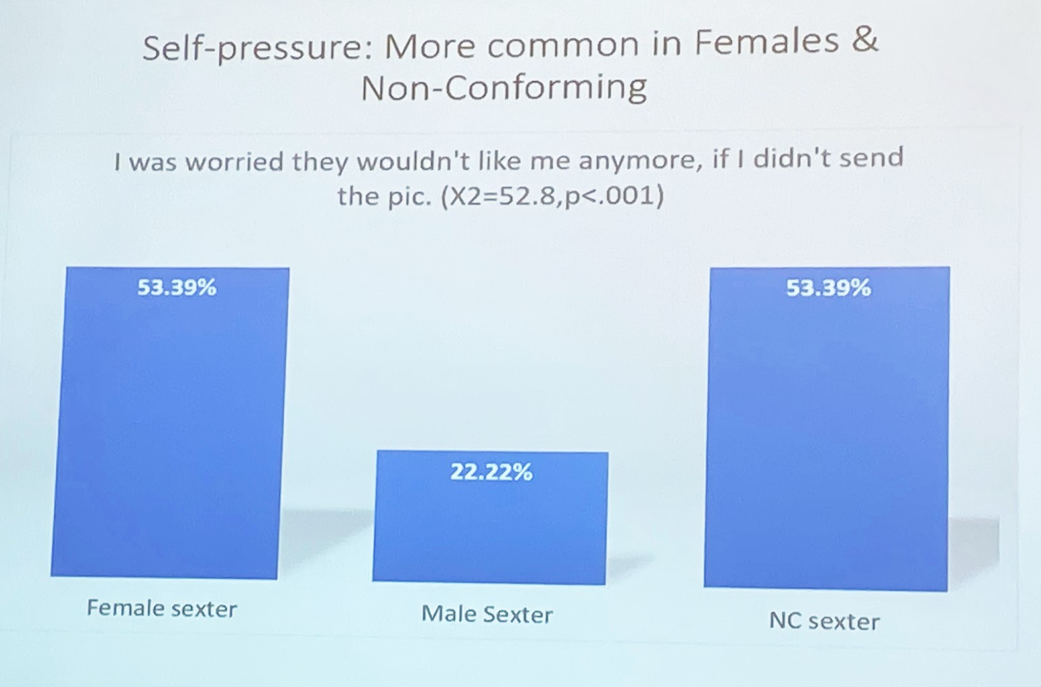

Slide 50
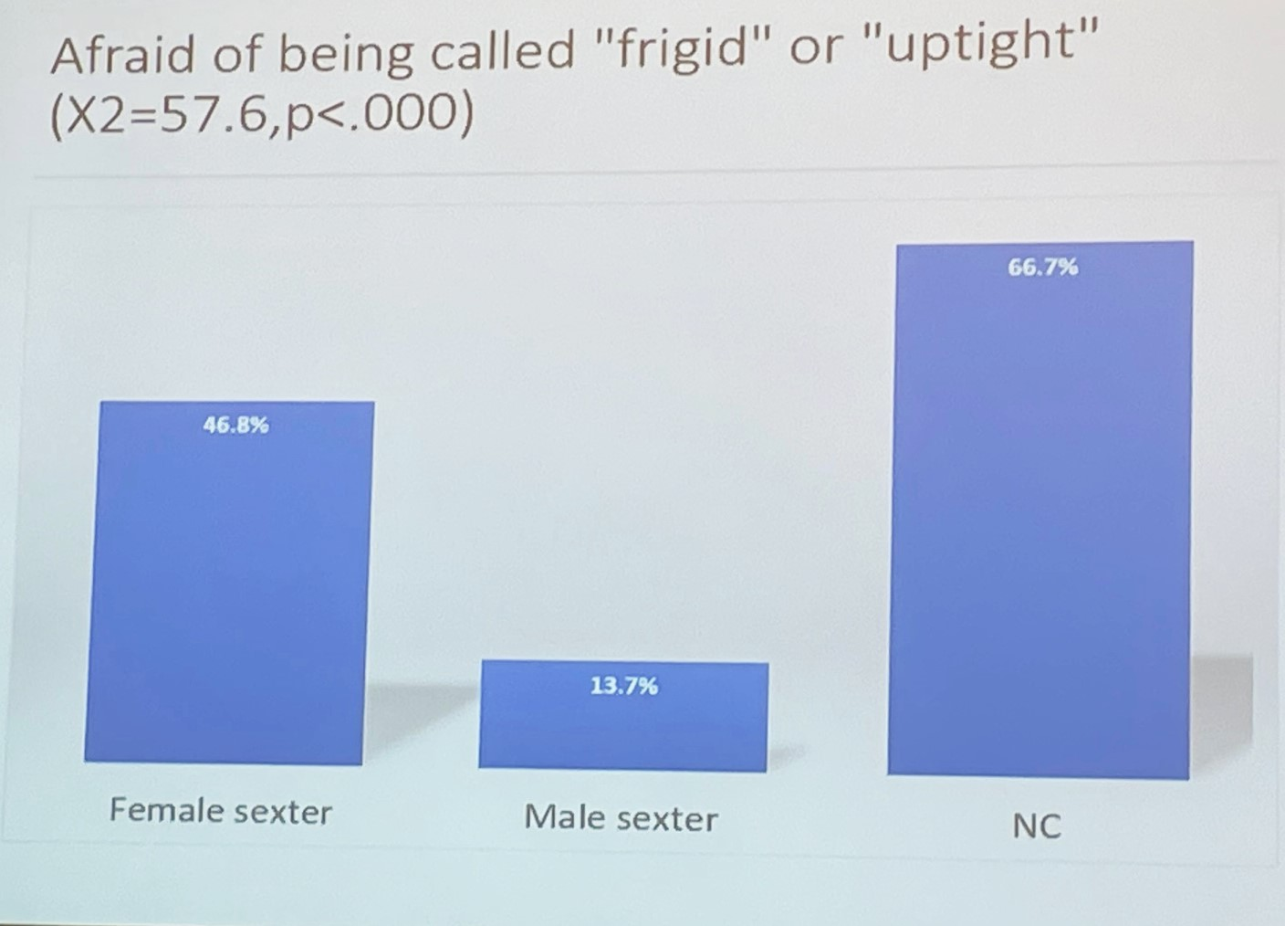

Slide 53
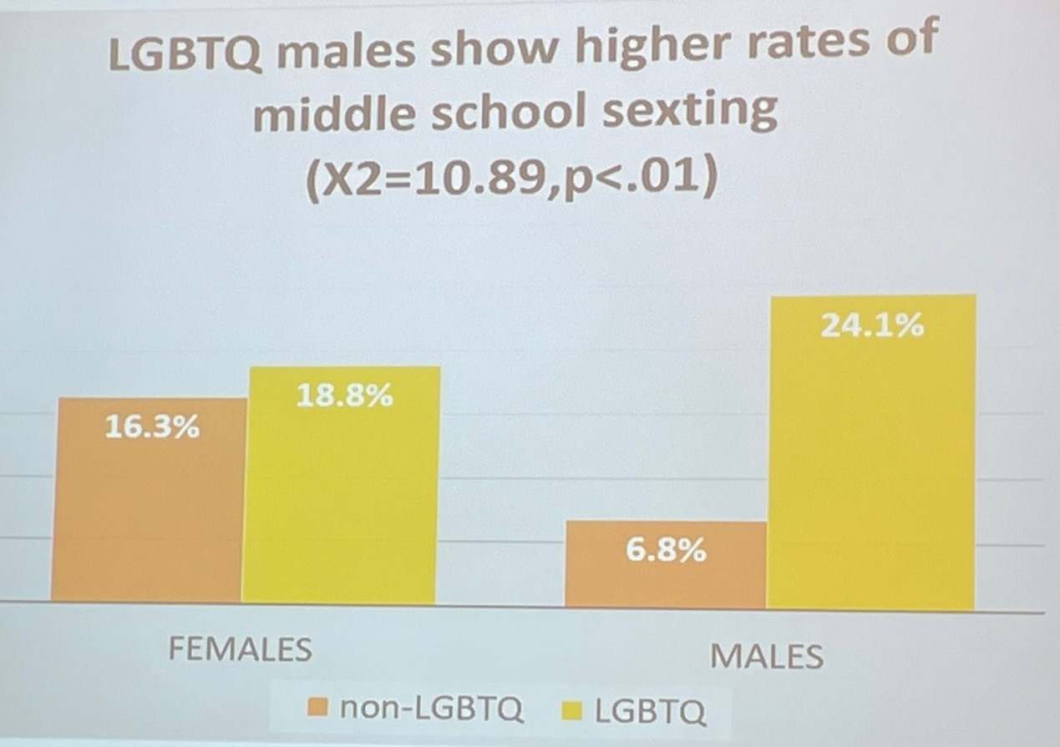

Slide 57
What does it mean by enticement of a child?
A person twenty-one years of age or older commits the offense of enticement of a child if he or she persuades, solicits, coaxes, entices, or lures whether by words, actions or through communication via the internet or any electronic communication, any person who is less than fifteen years of age, with the purpose of child molestation or indecent acts. The offense carries a sentence of 10 to 30 years.

Slide 58
Cyberstalking Cyberstalking can be defined as using technology to induce fear, to threaten, to annoy, or otherwise harass someone else. Cyberstalking is a crime in many states.
Hinduja, Sameer K.; Patchin, Justin W.. Bullying Beyond the Schoolyard: Preventing and Responding to Cyberbullying (p. 28). SAGE Publications. Kindle Edition.

Slide 59
United States District Court Judge Silvia Carreño Coll sentenced Iván Santell-Velázquez to 13 months in prison and two years of supervised release for cyberstalking.
Documents presented to the court showed Santell-Velázquez, while a student at the University of Puerto Rico at Cayey, sent unauthorised emails to faculty, administration, and students under the moniker “Slay3r_r00t”. He targeted over 100 student email accounts and used phishing and spoofing schemes to successfully break into multiple university e-mail accounts. Santell-Velázquez also hacked into several female students’ Snapchat accounts between 2019 and 2021, some of which contained nude images that he shared with third parties who published the images online.
Special Agent in Charge of the FBI San Juan Field Office, Joseph González, commented: “Cyberstalking can have a major impact on its victims, which can range from suicidal ideation, fear, anger, depression, to PTSD. This is why, at the FBI we are committed to investigating these terrible crimes and we urge the public to report incidents to law enforcement immediately.”

Slide 60
Título 33. Código Penal
Parte Especial, 1937
Parte VII. Delitos contra la Honestidad y Moral Pública
Capítulo 99. Ley contra la Venganza Pornográfica de Puerto Rico
1342. Definiciones
1344. Conducta delictiva; Penalidades
December 15, 2022
1342. Definiciones
(a) “Comunicaciones electrónicas”- Se refiere a los correos electrónicos, comunicaciones escritas o conversaciones vía aplicaciones (Apps), video-llamadas, mensajes de texto (SMS), mensajes MMS, chats, mensajería instantánea, transmisiones inalámbricas ya sea por IRDA, Bluetooth, WIFI, redes sociales, páginas de Internet o por cualquier otro método electrónico mediante el cual una parte reciba o envíe información.
(b) “Material Explícito”- Todo material de contenido íntimo o sexual que incluya alguna imagen del cuerpo humano o sus partes; o sexualmente explícito que incluya algún tipo de actividad sexual; íntima o de pareja, ya sea visual, ilustrativo o gráfico, grabaciones de video o audio.
(c) “Medio de comunicación electrónica o cibernética”- Incluye, pero no se limita a: IRDA, Bluetooth, WIFI, celulares, computadoras, tabletas o cualquier otro dispositivo con el que puedan enviarse comunicaciones electrónicas; así como herramientas de comunicación, tales como, redes sociales, mensajes de texto, chats, mensajería instantánea y páginas de Internet.
“Ley Contra el Acecho en Puerto Rico”
Ley Núm. 284 de 21 de Agosto de 1999

Slide 61
Puerto Rico has included cyberbullying in its Criminal Code.
According to Section 178 – Intrusion into personal tranquility,
“any person who, through telematic communication, or by any other means, utters or writes threatening, abusive, obscene, or lewd language to another person; or who, for the purpose of annoying any person, repeatedly makes telephone calls or causes another person’s telephone to ring repeatedly, or any person who knowingly authorizes that any telephone under his/her control be used for any purpose prohibited in this Section, will incur in misdemeanor”.

Slide 62
Cyberbullying Specific to Gaming Environments
The last time was yesterday or almost every day I get on Xbox. Sometimes I have bad games and people sometimes say I suck and need to die in a hole or go kill myself just cuz we are losing a game on Xbox live on Call of Duty: Black Ops II. (Teenager, undisclosed location in the U.S.)
Hinduja, Sameer K.; Patchin, Justin W.. Bullying Beyond the Schoolyard: Preventing and Responding to Cyberbullying (p. 29). SAGE Publications. Kindle Edition.

Slide 63
Cyberbullying in the Metaverse
“I’ve never been harassed or bullied in any other social VR app until I played Echo VR. The other day I was in the middle of a game and out of nowhere some guy on the other team started calling me a bitch and a whore. I’m old enough to handle it, but it was just so immature and toxic. I just wanted to chill and play the game. Usually I hear crap like this from younger kids but this was an older sounding guy. So I can just imagine how many younger players get bullied.”
Hinduja, Sameer K.; Patchin, Justin W.. Bullying Beyond the Schoolyard: Preventing and Responding to Cyberbullying (p. 31). SAGE Publications. Kindle Edition.

Slide 64
METAVERSE
In his 1992 science fiction book Snow Crash28 author Neal Stephenson coined the term and used it to describe an Internet-based virtual world in which users can build digital realities and share experiences through their avatars.
Hinduja, Sameer K.; Patchin, Justin W.. Bullying Beyond the Schoolyard: Preventing and Responding to Cyberbullying (p. 31). SAGE Publications. Kindle Edition.

Slide 65
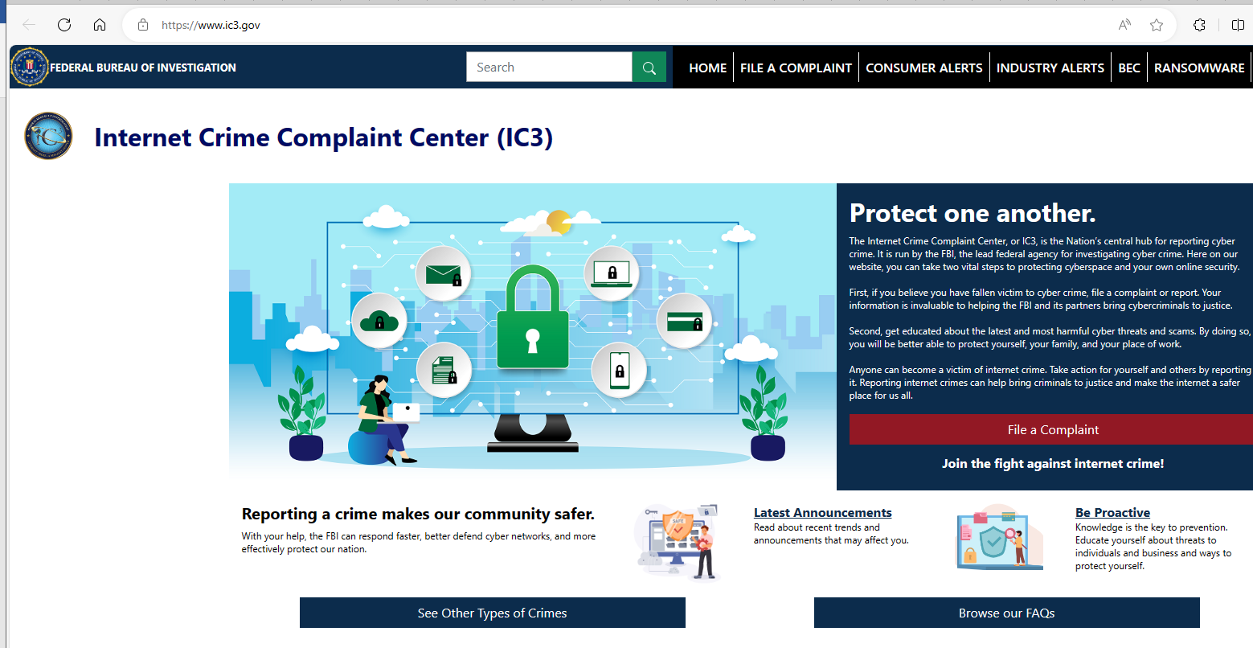

Slide 66
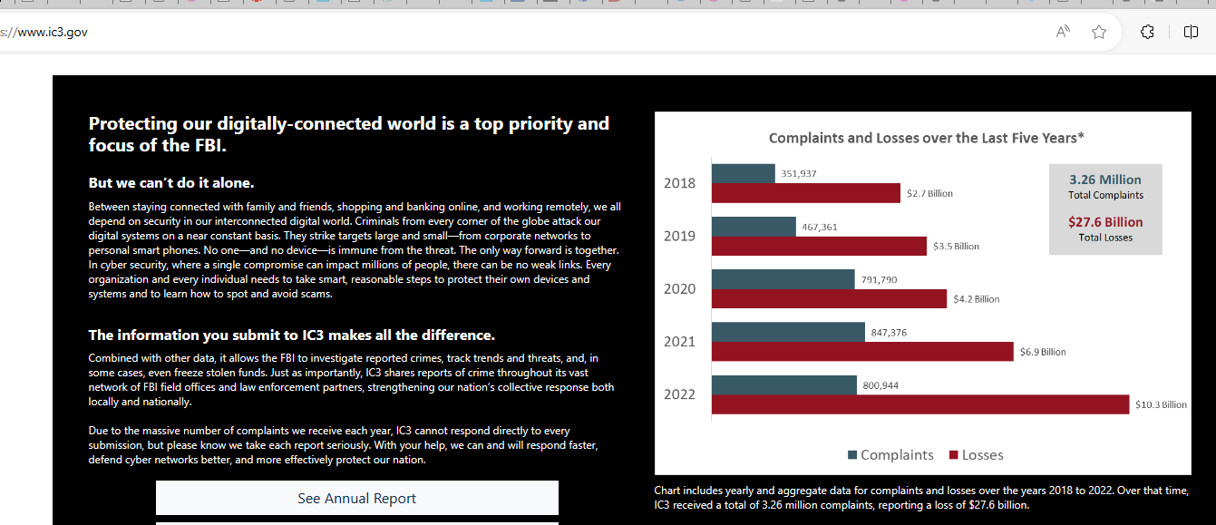

Slide 67
Bias-Based Abuse and Hate - LABELING
Online hate, which has been conceptualized as online actions that “demean or degrade a group and its members based on their race/ethnicity, national origin, sexual orientation, gender, gender identity, religion, or disability status.”
Hinduja, Sameer K.; Patchin, Justin W.. Bullying Beyond the Schoolyard: Preventing and Responding to Cyberbullying (p. 32). SAGE Publications.

Slide 68
5 ways to be an ally when you witness bullying or harassment
Don’t Support people who are targets for bias and/or bullying, whether you know them or not.
Don’t Participate
Tell the person who is showing unkind behaviors to stop
Inform a trusted adult in school and at home
Get to know people instead of judging them. 5. Be an ally online

Slide 69
Empathy is a concerned response to another person’s feelings. It involves feeling, thinking, and even a physical reaction that our bodies have to other people when we relate to how they feel.
A key component of practicing kindness and empathy with others is showing patience, generosity, and a willingness to hear someone else’s perspective.

Slide 70
Intentional inclusion is when you accept, value, and include someone who is different from you.
Allyship, or being an ally, is showing compassion and support for someone or communities who might be a target of bias and or bullying.

